Slide 1
Settings Menu
Register Page
Login page
Settings menu

Slide 2
Agenda
Introduction
Settings Menu Overview
Settings Options
Implementation Details
Results
Conclusion

Slide 3
Introduction
The settings menu allows users to customize their experience and manage preferences.
To access the settings, click on the gear icon located at the top right corner of the Home screen.
Understanding the settings menu empowers users to tailor the application to suit their needs and preferences.
This Feature is developed using Java and Android Studio, focusing on user experience and seamless navigation.

Slide 4
Settings Menu Overview
The settings menu contains various options for users to configure their app settings.
Each option leads to a detailed screen with relevant information and settings.
The goal is to provide a comprehensive yet user-friendly interface.

Slide 5
Settings Options
Lock Screen
About Mobile
Help
Home Screen and Lock Screen Settings
Display Settings
Password Settings
Wi-Fi Connection
Location
Storage
Additional Settings
Software Update

Slide 6
Implementation Details
Create Activities for Login, Register, Settings, and Home.
Set Up Layouts for Each Activity.
Implement Validation for Email and Password.
Implement Navigation Between Activities.
Handle Settings Menu and Display Information for Each Option.
Create Activities:
LoginActivity.java
RegisterActivity.java
SettingsActivity.java
HomeActivity.java
SettingsDetailActivity.java
Create layouts:
Activity_login.xml
Activity_register.xml
Activity_home.xml
Activity_settings.xml
Activity_settings_detail.xml

Slide 7
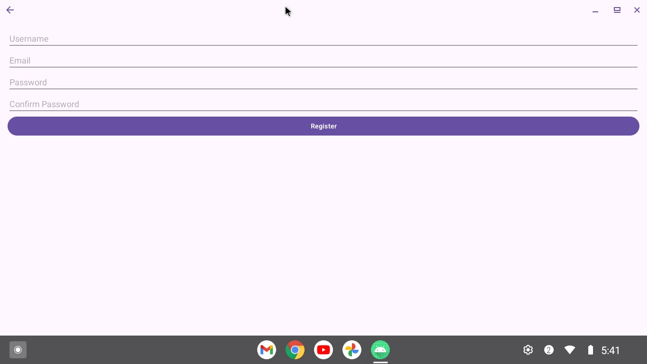
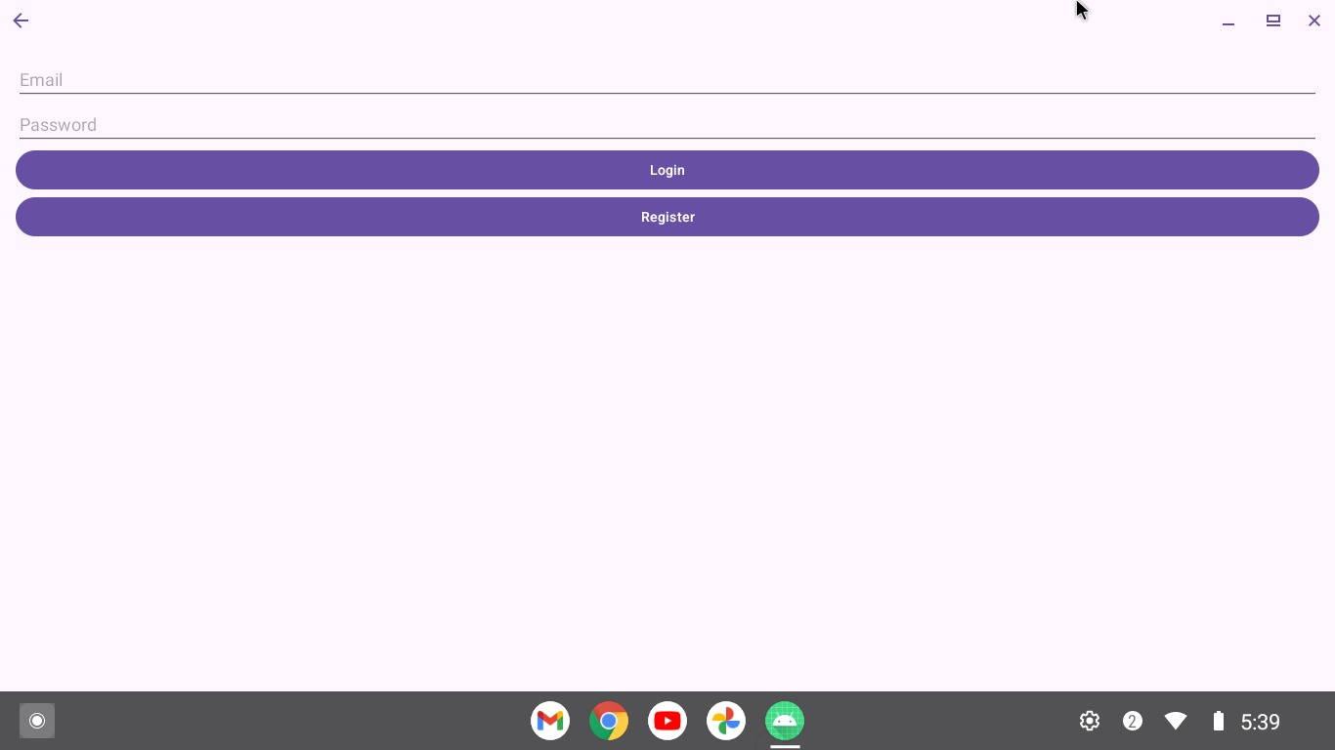
RESULTS

Slide 8
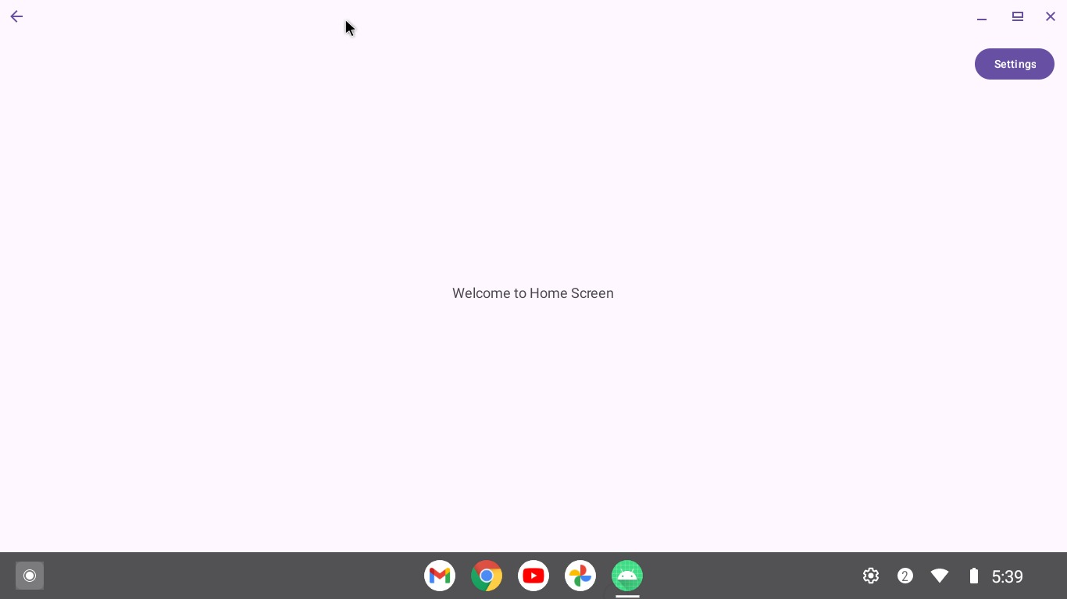
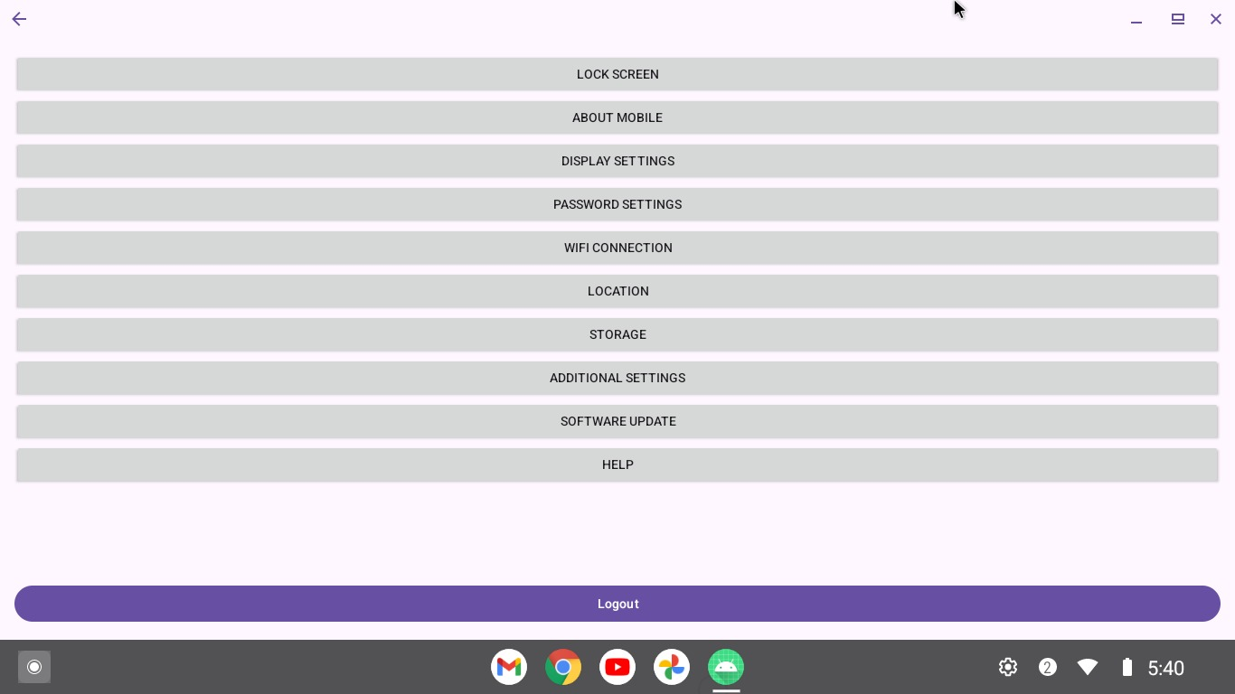
results

Slide 9
Conclusion
Summary of the settings menu features and implementation.
Emphasis on providing a comprehensive and user-friendly settings interface.
Future enhancements and improvements to add more features and optimize performance.

